Slide 1
The Health Information Partnership for Tennessee www.hiptn.org

Slide 2
HIP TN Mission and Vision
Mission - HIP TN is a Tennessee not-for-profit organization that works to improve access to health information through a statewide collaborative process by providing services and infrastructure for the secure electronic exchange and use of health information.
Vision - HIP TN will be a recognized state and national leader that supports measureable improvement in clinical quality and efficiency to healthcare consumers, providers, and payors through the provision of secure HIE services.

Slide 3
Health Information Exchange in Tennessee
General approach: Leverage investments and lessons learned at the regional level to enable the exchange of health information at the state level.
Support and fund a not-for-profit organization to facilitate statewide HIE
State will receive federal funds and invest in infrastructure that supports statewide HIE and facilitates providers becoming “Meaningful Users”
State will be responsible for enabling Meaningful Use
HIP TN will be responsible for enabling statewide HIE

Slide 4
HIP TN – Board Representation
Providers/Clinicians:
**BW Ruffner (Medical Oncologist at Erlanger/President of TMA)
Kathy Wood Dobbins (CEO of TNPCA)
**Rick Sain (Owner of Reeves Sain Pharmacy/Tennessee Pharmacists Association past president)
Diane Pace (Assistant Dean of the Faculty Practice at UT College of Nursing/ Tennessee Nursing Association member)
Dawn Fitzgerald (CEO of QSource)
RHIOs:
**Bob Gordon (Exec Vice President and Chief Administrative Officer of Baptist Memorial Health Care Corporation/MidSouth eHealth Alliance Board Member)
Clifton Meador (Executive Director of the Vanderbilt–Meharry Alliance/Middle TN eHealth Connect Board Member )
**Doug Varney (President and CEO of Frontier Health/CareSpark Board Chair)
Hospitals:
**Reginald Coopwood (CEO of The MED/Tennessee Hospital Association Board Member)
Health Plans:
**Robert McLaughlin (Market Medical Executive for CIGNA Healthcare in TN)
**Robert Mandel (Senior Vice President of Healthcare Services for BCBST)
Large employer:
**David Sensibaugh (Director of Integrated Health for Eastman Chemical)
Consumer advocacy:
**Patrick Willard (Advocacy Director for AARP TN)
** Denotes founding Board member

Slide 5
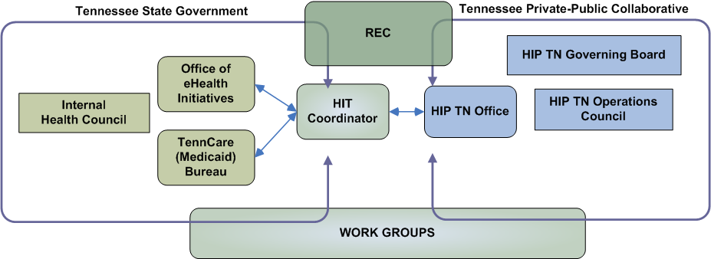
Coordination of HIE in TN

Slide 6
HIP TN – The Organization
HIP TN Board
Founded 8/2009
Operations Council
Formed 12/2009
Technology Workgroup
Formed 3/2010
Clinical Workgroup
Formed 3/2010
Privacy & Security Workgroup Formed 3/2010
Sustainability Workgroup
Formed 3/2010
Consumer Advisory Group
Formed 7/2010
HIP TN Workgroups have representation from different sectors from across the state as well as from Tennessee state agencies.

Slide 7
HIP TN Network Project Overview
Qualified
Organizations:
With gateways to access Core Services
Core Services: Procured or managed by HIP TN
Candidate Enterprise Services: Procured or provided by State Agencies
Immunization
Registry
Modernization
A
Service Access Layer
Trust
Broker
Enterprise Service #2
Matching Service
Enterprise Service #3
B
Master Facilities Index
C
Candidate Value-Added
Services: Procured or provided by HIP TN, QO’s, and/or vendors
Patient Access
Master Clinician Index
CCD Translation
D
Eligibility Checking
NHIN Gateway
Decision Support
Lab Translation

Slide 8
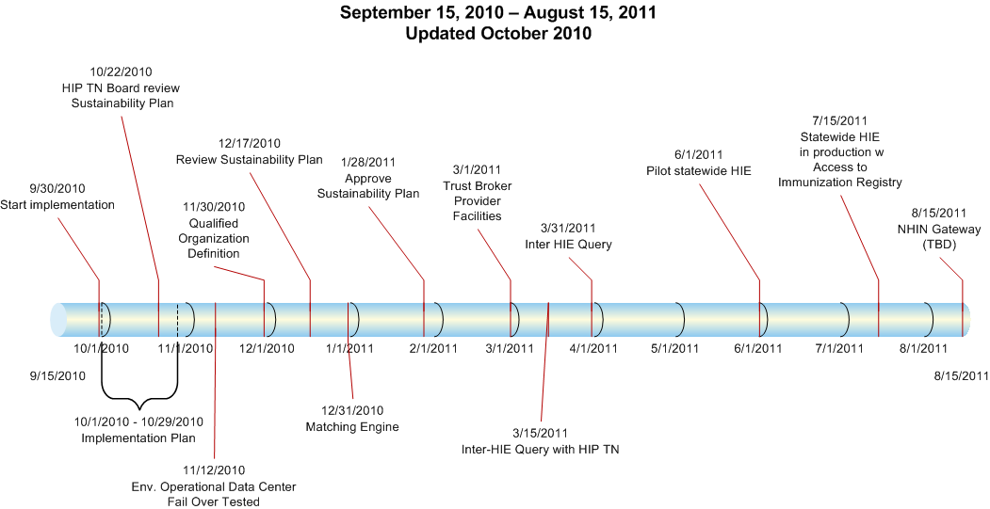
DRAFT HIP TN Network
Project Timeline

Slide 9
HIP TN Accomplishments
Established a workgroup structure to provide input and feedback from a broad set of stakeholders regarding statewide HIE
March - present
Assisted the Office of eHealth in the drafting of the State Plan submitted to the Office of the National Coordinator
Convened stakeholders January – May to provide input and feedback on the plans
Strategic Plan and Operational Plan for statewide HIE delivered to ONC the first week of June
Tennessee was notified the week of September 13th that they are one of the first states to have their State Plan approved after a release of a Program Information Notice (PIN) that was released in July 2009 clarifying requirements for the State Plan.
Published an RFP for Core Services on June 25, 2010
RFP was sent to 40+ vendors
Formed an evaluation team of 50+ stakeholders that reviewed proposal and vendor demonstrations to narrow down the list of vendors
Began negotiations in August 2010 to establish a vendor to provide the core services with the intention of being “live” by July 2011
Signed a contract with Axolotl on September 30th

Slide 10
What’s next
Implementation officially started on September 30th when contract was signed
Developing a detailed project plan by end of October that outlines all activities related to implementation through July 2011 AND describes the systematic roll out through July 2012
Finalize definition of Qualified Organization
Initial use cases involve providers (in different Qualified Organizations) access to patient data at point of care and access to the immunization registry
Work on policies and agreements to allow data sharing through the HIP TN network
There will likely be pilots in early 2011 to test the solution and refine the implementation
Goal is to have the HIP TN statewide HIE infrastructure in production no later than July 2011

